Slide 1


Aakash for School Education
Summer Internship - 2014
IIT Bombay
Under the Guidance of
Prof. Deepak B. Phatak
Project Managers:
Dr. Kiran Khosla
Mr. Parag Tiwari
5th July 2014

Slide 2


UML Hierarchy
Project - 1
‘Virtualis’
Labs on the fly
Virtual Laboratory

Slide 3
UML Hierarchy
Project Overview
Objectives
Web Portal
Synced Android App
Lab Experiments
Evaluative Quiz
Guided Simulations

Slide 4
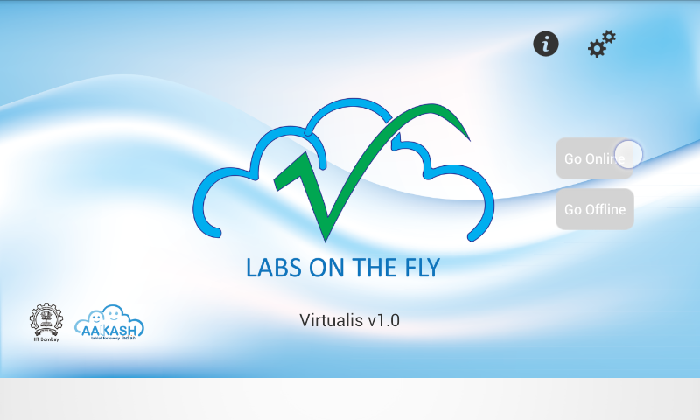
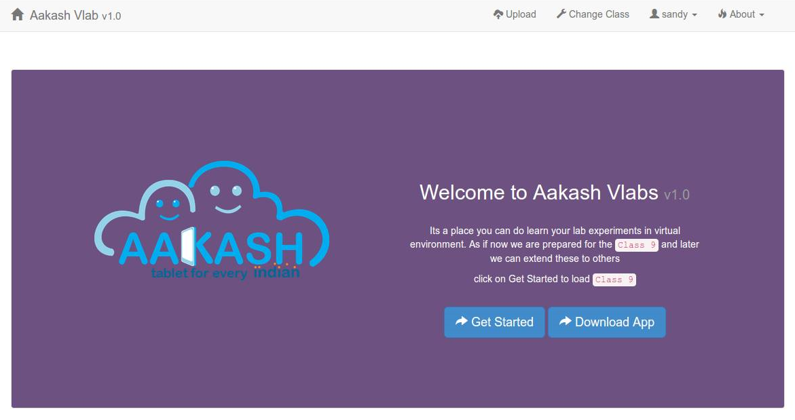
UML Hierarchy
Home Screens
Android Interface
Web Interface

Slide 5
Technical Challenges Faced
Challenges:
Simulation
Sync between Web and Android
Quiz Module
Content Management

Slide 6
Learning
What We Learnt?
Team Work
New Technologies
LaTex, Git, Canvas, Android

Slide 7
Future Enhancement
UML Hierarchy
Language localization
More functions in simulation
GUI for adding quizzes
Contributor Module in Android app
Student profiles

Slide 8

Project – 2
UML Hierarchy
Learn . Quiz . Assess
A Group & Peer based Quizzing System

Slide 9
UML Hierarchy
Project Overview
Objectives
Peer Quizzing
Enhance learning process
Quality questions
Performance evaluation & analysis
Notes:
1. It is a group quizzing system. Students divided into groups and ask questions to each other.
2. This enhances the learning of students as they dig deeper into the subjects taught. As a result, they come up with more quality questions.
3. After the quiz, system evaluates and gives result to the teacher for analysis.

Slide 10
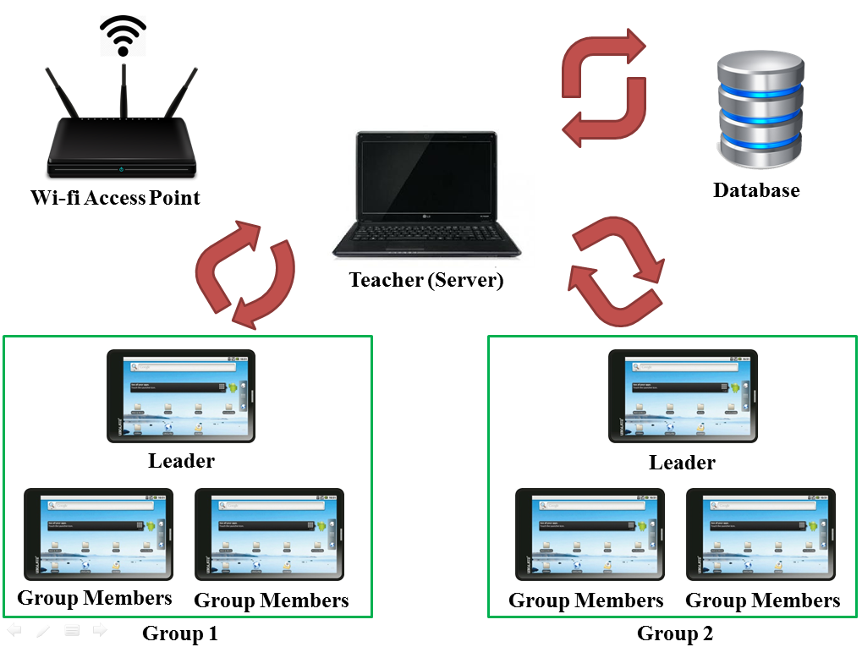
UML Hierarchy
Working – G&P Quizzing System
Notes:
1. Components are a server, teacher works on the server, tablet clients and a wireless access point.
I will explain the main module, the quiz.
2. Teacher starts a quiz session and parameters are filled. Students log in and leader formation sessions start. Next, the leader names are sent and those who aren’t leaders select their preferred leaders and this way groups are formed. Teacher starts the quiz and one group leader gets the interface to ask a question.
3. Question is first sent to the teacher and she verifies it. If verified, a level is given and sent to all other students for answering. The answers are verfied and students get evaluated accordingly. This continues for the required number of rounds.

Slide 11
Technical Challenges Faced
Challenges:
Make UDP reliable.
Leader goes out of the network - system halts.
Notes:
We used UDP broadcast packets for the entire quiz module, because of the light weight traffic. With testing, we found it very unreliable. So, we modified the protocol by introducing acknowledgements.
Also, a leader is very important factor in the quiz. If he goes out, the entire system halts. So, we made the system choose a different leader from the members of the same group.

Slide 12
Learning
What we learnt:
Android and network programming.
Modifying an existing transmission protocol to serve our requirement.
Working in groups and teamwork.
Notes:
Tablets work on android environment and network programming for server and clients interactions.
Modifying the UDP protocol to make it reliable and serve our purpose was a great learning curve
Working in a group was very enjoyable.

Slide 13
Future Enhancement
UML Hierarchy
Intra group communication.
Better data visualization, analysis.
Peer-to-peer assignment evaluation.
Notes:
We assume intra group discussion to be physical. A chat interface can be implemented.
Data visualization can be improved for better analysis
Peer evaluation feature where teacher uploads assignments and students download, solve and submit. Students will assess fellow students’ assignments.

Slide 14
UML Hierarchy
Project - 3
Content Contribution Portal
For
School Education

Slide 15
UML Hierarchy
Project Overview
Objectives
Aakash Web portal is a free content providing website.
To bridge the distance between world class education and under privileged students who face difficulty in accessing quality education.

Slide 16
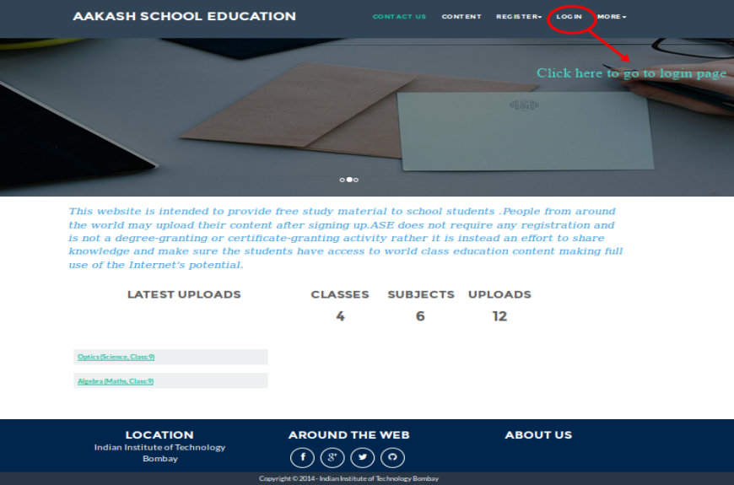
UML Hierarchy
Home Page

Slide 17
Technical Challenges Faced
Challenges:
Choosing the appropriate Web-framework.
It was a tough decision since there were so many available.
Scarce knowledge about Python and Django.

Slide 18
Learning
Technical Learning:
Python programming
Django framework
Git
Html
CSS
JavaScript
UML diagrams

Slide 19
Learning
Non - Technical Learning:
Teamwork
Patience
Time management

Slide 20
Future Enhancement
UML Hierarchy
Interface of the website content can be
displayed in different languages.
Facility for quiz and comprehensive tests for
students can be implemented to help a student
check his/her understanding level.

Slide 21
Thank You

